Slide 1

Design & Analysis of Algorithm
Lecture 1
Bushra Fazal(Assistant Professor)
Department of Software Engineering
Bahria University Karachi Campus

Slide 2
Course Information
Course webpage
BUKC-LMS
Grading policy
  Assign. 20%, Quizzes.10% Midterm: 20%, Final: 50%

Slide 3
More Information
Textbook
  Algorithms. Jeff Erickson(2019) 1st ed.
  Data Structures and Algorithm Analysis
Clifford A. Shaffer,Edition 3.2 (C++ Version),2012.
Others
  Introduction to Design & Analysis Computer Algorithm 3rd, Sara Baase, Allen Van Gelder, Adison-Wesley, 2000.
  Algorithms, Richard Johnsonbaugh, Marcus Schaefer, Prentice Hall, 2004.
  Introduction to The Design and Analysis of Algorithms 2nd Edition, Anany Levitin, Adison-Wesley, 2007.

Slide 4
COURSE LEARNING OUTCOMES (CLOS):
Upon completion of this course, students will be able to:
CLO # | CLO Statements | Bloom’s Taxonomy Code
CLO 1 | Describe the basic concepts related to design and analysis of algorithms | C1
CLO 2 | Explain the working mechanism of algorithmic design paradigms and approaches used to analyze those algorithms | C2
CLO 3 | Design algorithms in pseudo-code of given problems | C3
CLO 4 | Analyze the asymptotic performance of the algorithms | C4

Slide 5
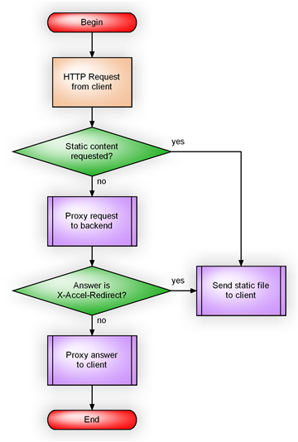
Introduction
What is an algorithm?
  a step-by-step procedure to solve a problem
  every program is the instantiation of some algorithm
http://blog.kovyrin.net/wp-content/uploads/2006/05/algorithm_c.png

Slide 6

Sorting Example
Solves a general, well-specified problem
  given a sequence of n keys, a₁,…,a_{n}, as input, produce as output a reordering b₁,…,b_{n} of the keys so that
  b₁ ≤ b₂ ≤ … ≤ b_{n}.
Problem has specific instances
  [Dopey, Happy, Grumpy] or [3,5,7,1,2,3]
Algorithm takes every possible instance and produces output with desired properties
  insertion sort, quicksort, heapsort, …

Slide 7
Challenge
Hard to design algorithms that are
  correct
  efficient
  implementable
Need to know about
  design and modeling techniques
  resources - don't reinvent the wheel

Slide 8
Correctness
How do you know an algorithm is correct?
  produces the correct output on every input
Since there are usually infinitely many inputs, it is not trivial
Saying "it's obvious" can be dangerous
  often one's intuition is tricked by one particular kind of input

Slide 9

Tour Finding Problem
Given a set of n points in the plane, what is the shortest tour that visits each point and returns to the beginning?
  application: robot arm that solders contact points on a circuit board; want to minimize movements of the robot arm
How can you find it?

Slide 10
Finding a Tour: Nearest Neighbor
start by visiting any point
while not all points are visited
  choose unvisited point closest to last visited point and visit it
return to first point
works well here

Slide 11
Nearest Neighbor Counter-example
-21 -5 -1 0 1 3 11
works poorly here

Slide 12
How to Prove Correctness?
There exist formal methods
  even automated tools
  more advanced than this course
In this course we will primarily rely on more informal reasoning about correctness
Seeking counter-examples to proposed algorithms is important part of design process

Slide 13
Efficiency
Software is always outstripping hardware
  need faster CPU, more memory for latest version of popular programs
Given a problem:
  what is an efficient algorithm?
  what is the most efficient algorithm?
  does there even exist an algorithm?

Slide 14
How to Measure Efficiency
Machine-independent way:
  analyze "pseudocode" version of algorithm
  assume idealized machine model
    one instruction takes one time unit
"Big-Oh" notation
  order of magnitude as problem size increases
Worst-case analyses
  safe, often occurs most often, average case often just as bad

Slide 15
Faster Algorithm vs. Faster CPU
A faster algorithm running on a slower machine will always win for large enough instances
Suppose algorithm S1 sorts n keys in 2n² instructions
Suppose computer C1 executes 1 billion instruc/sec
  When n = 1 million, takes 2000 sec
Suppose algorithm S2 sorts n keys in 50nlog₂n instructions
Suppose computer C2 executes 10 million instruc/sec
  When n = 1 million, takes 100 sec

Slide 16
Caveat
No point in finding fastest algorithm for part of the program that is not the bottleneck
If program will only be run a few times, or time is not an issue (e.g., run overnight), then no point in finding fastest algorithm

Slide 17
What do we analyze about them?
Correctness
  Does the input/output relation match algorithm requirement?
Amount of work done (aka complexity)
  Basic operations to do task finite amount of time
Amount of space used
  Memory used

Slide 18
Strengthening the Informal Definition
Important Features:
  Finiteness.[algo should end in finite amount of steps]
  Definiteness.[each instruction should be clear]
  Input.[valid input clearly specified ]
  Output.[single/multiple valid output]
  Effectiveness.[ steps are sufficiently simple and basic]

Slide 19

RAM model
has one processor
executes one instruction at a time
each instruction takes "unit time“
has fixed-size operands, and
has fixed size storage (RAM and disk).

Slide 20
Example Of Algorithm

Slide 21
Few Classical Examples
Classical Multiplication Algorithms
English
American
A la russe
Divide and Conquer

Slide 22
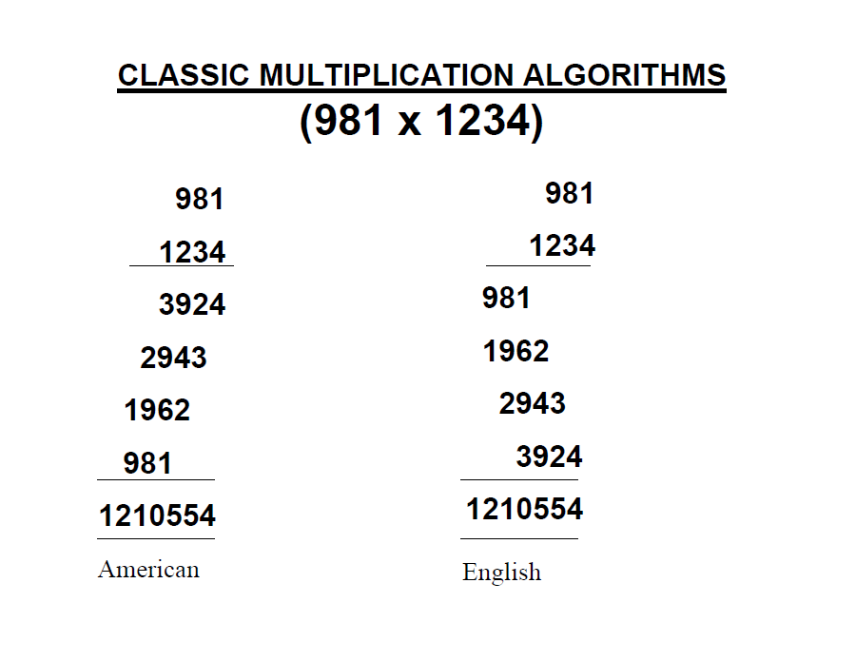
Classic Multiplication

Slide 23
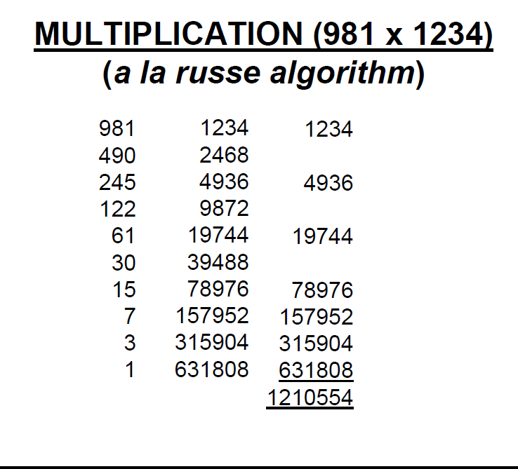
Multiplication

Slide 24
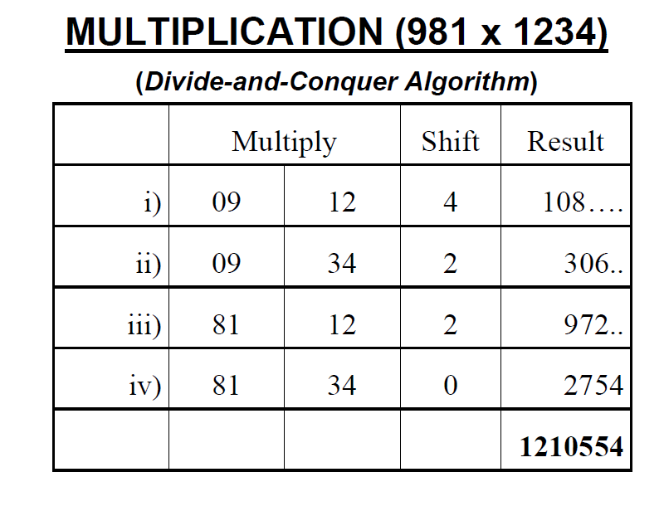
Multiplication

Slide 25

The Selection Problem
Which algorithm is better?

Slide 26
Which algorithm is better?
The algorithms are correct, but which is the best?
Measure the running time (number of operations needed).
Measure the amount of memory used.
Note that the running time of the algorithms increase as the size of the input increases.

Slide 27
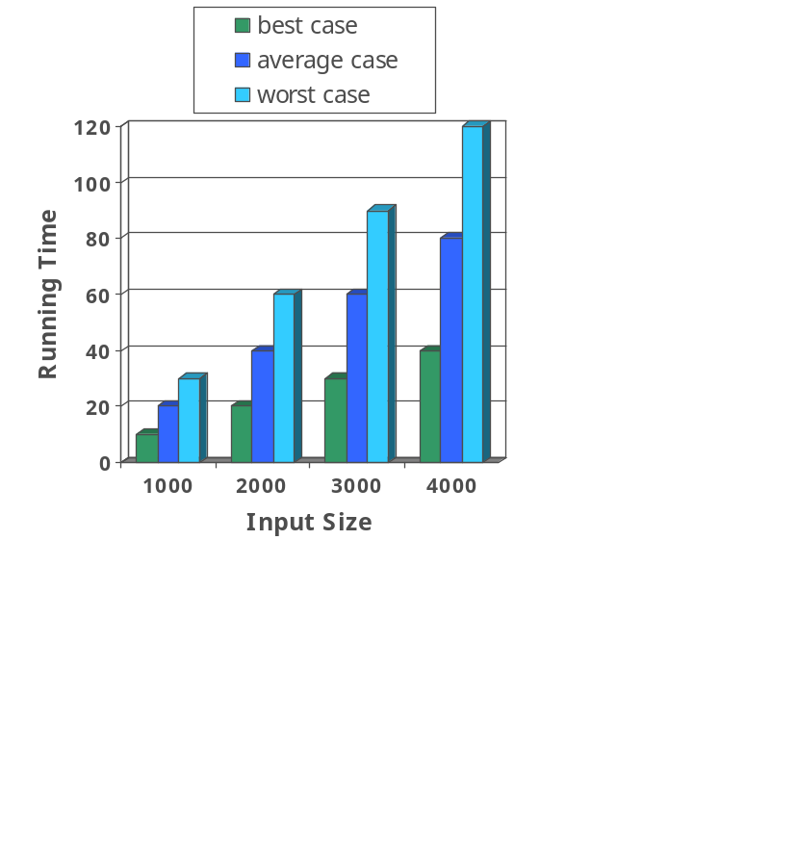
Running Time
Most algorithms transform input objects into output objects.
The running time of an algorithm typically grows with the input size.
Average case time is often difficult to determine.
We focus on the worst case running time.
  Easier to analyze
  Crucial to applications such as games, finance and robotics

Slide 28
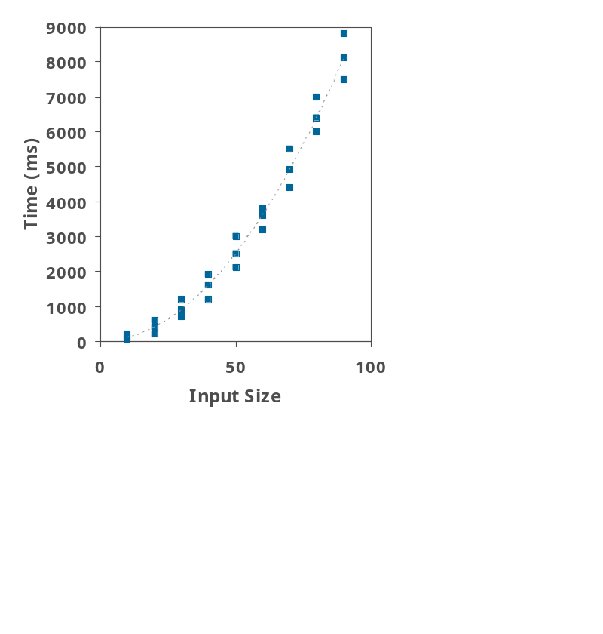
Experimental Studies
Write a program implementing the algorithm
Run the program with inputs of varying size and composition
Use a method like System.currentTimeMillis() to get an accurate measure of the actual running time
Plot the results

Slide 29
Limitations of Experiments
It is necessary to implement the algorithm, which may be difficult
Results may not be indicative of the running time on other inputs not included in the experiment.
In order to compare two algorithms, the same hardware and software environments must be used

Slide 30

Theoretical Analysis
Uses a high-level description of the algorithm instead of an implementation
Characterizes running time as a function of the input size, n.
Takes into account all possible inputs
Allows us to evaluate the speed of an algorithm independent of the hardware/software environment

Slide 31
Complexity
Time complexity:
  How much time it takes to compute
  Measured by a function T(N)
Space complexity:
  How much memory it takes to compute
  Measured by a function S(N)

Slide 32
Modeling the Real World
Cast your application in terms of well-studied abstract data structures
Concrete | Abstract
arrangement, tour, ordering, sequence | permutation
cluster, collection, committee, group, packaging, selection | subsets
hierarchy, ancestor/descendants, taxonomy | trees
network, circuit, web, relationship | graph
sites, positions, locations | points
shapes, regions, boundaries | polygons
text, characters, patterns | strings

Slide 33
Real-World Applications
Hardware design: VLSI chips
Compilers
Computer graphics: movies, video games
Routing messages in the Internet
Searching the Web
Distributed file sharing
Computer aided design and manufacturing
Security: e-commerce, voting machines
Multimedia: CD player, DVD, MP3, JPG, HDTV
DNA sequencing, protein folding
and many more!

Slide 34
Some Important Problem Types
Sorting
  a set of items
Searching
  among a set of items
String processing
  text, bit strings, gene sequences
Graphs
  model objects and their relationships
Combinatorial
  find desired permutation, combination or subset
Geometric
  graphics, imaging, robotics
Numerical
  continuous math: solving equations, evaluating functions

Slide 35
Algorithm Design Techniques
Brute Force & Exhaustive Search
  follow definition / try all possibilities
Divide & Conquer
  break problem into distinct subproblems
Transformation
  convert problem to another one
Dynamic Programming
  break problem into overlapping subproblems
Greedy
  repeatedly do what is best now
Iterative Improvement
  repeatedly improve current solution
Randomization
  use random numbers

